Slide 1
Application of feedback particle filter with diffusion-map-based gain to state-space models
Yiyi Ma
Supervised by Dr. Sahani Pathiraja, Prof. Lucy Marshall and
Prof. Scott Sisson

Slide 2
Outline
Background
Filtering Methods
Experiment Results
Future Works

Slide 3
Background

Slide 4


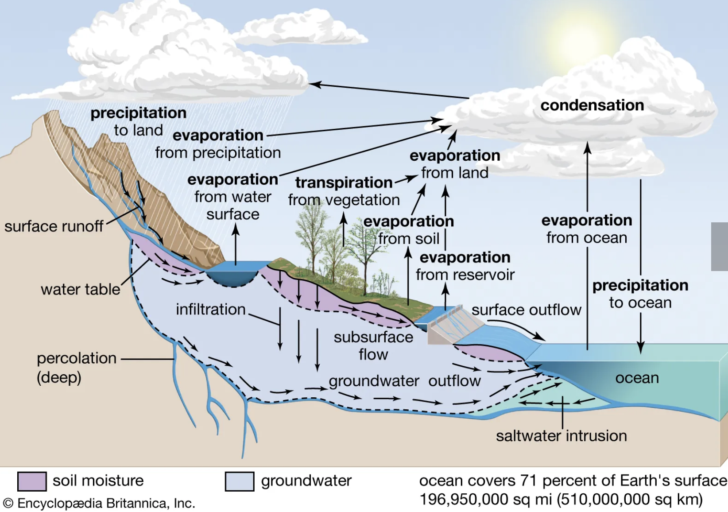
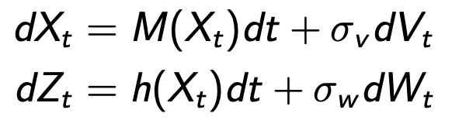
Background: the system
Chaotic dynamical systems:
Natural System:
small change in the initial conditions
fluid flow
weather
climate
heartbeat irregularities
large impact on prediction accuracy
State-Space model:

Slide 5


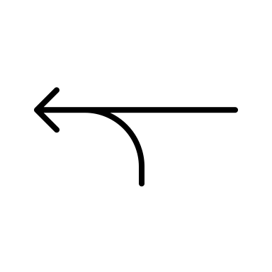


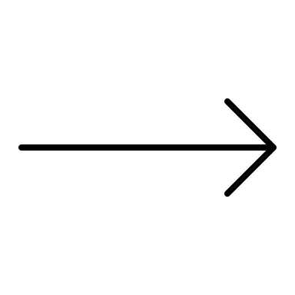



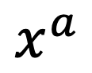
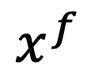
Background: the method
Why not just observations?
Sparse
Indirect
Error
Measured at different times
Why not just model?
Deviate from reality (model assumptions/approximations, initial conditions, chaotic behaviour, ··· )
Inaccurate predictions
Observation
Physical System
Forecast
Analysis
$$x^{f}$$
$$x^{a}$$
Data Assimilation
State-Space Model
Applied Areas:
Weather Forecasting
Atmosphere
Ocean
Land surface
···
Cycling

Slide 6
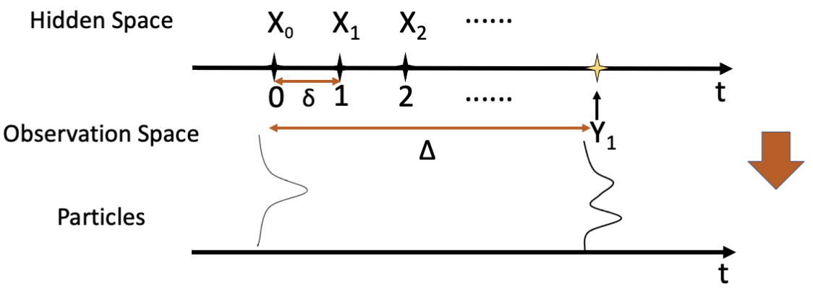
Background: the process

Slide 7
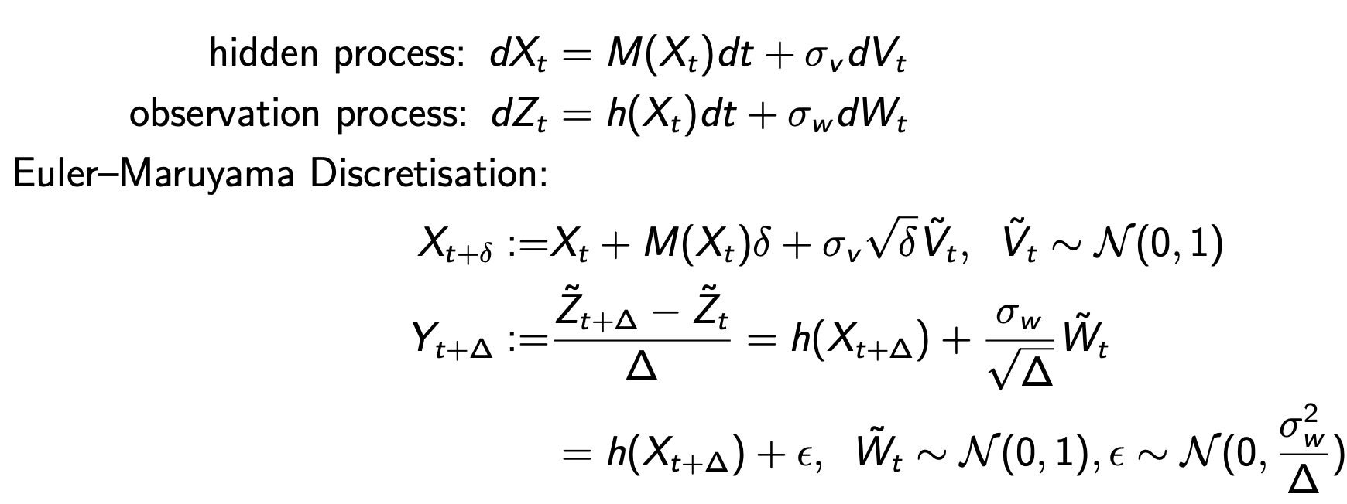
Background: the basic system equations

Slide 8
Filtering Methods

Slide 9
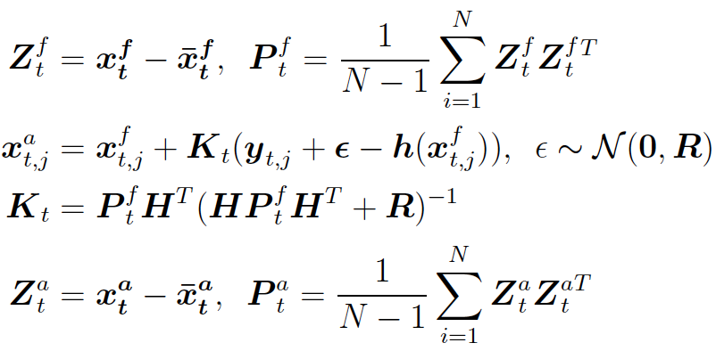
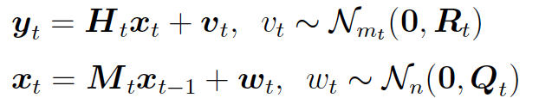
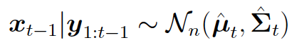
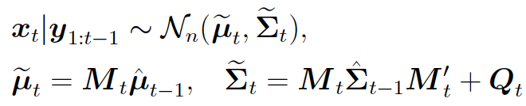
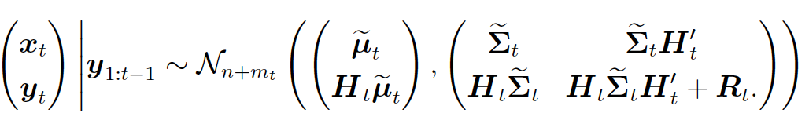
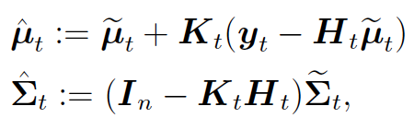
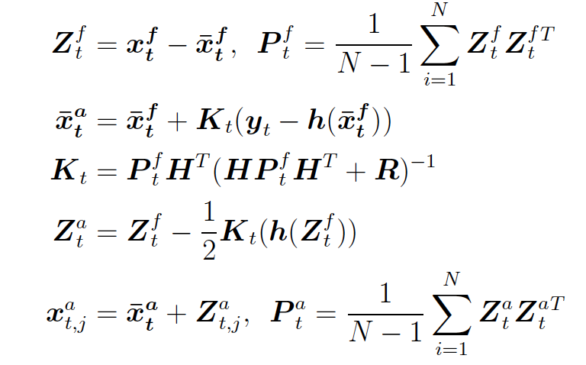
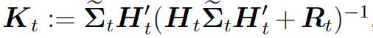
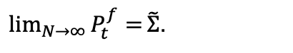
Methods: the benchmarks
Ensemble Methods:
N particles
non-linear & non-Gaussian
computationally feasible for high-dimensional situations
Kalman Filter:
Ensemble Kalman Filter (EnKF)
linear & Gaussian
explicit analytic formula
→
Deterministic Ensemble Kalman Filter ((DEnKF)
Virtual observations ensure
Virtual observations would bring sample error to the model for small N.
$\lim_{N→∞}{P_{t}^{f}=}\tilde{Ʃ}$.
Kalman gain

Slide 10
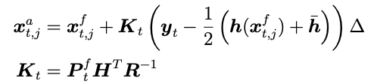
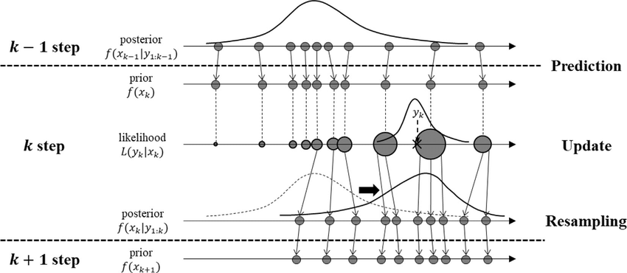
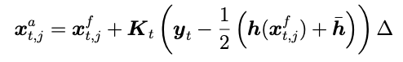
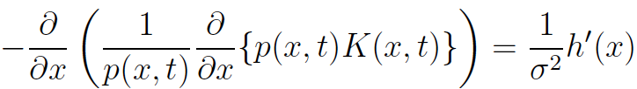
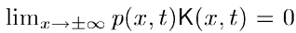
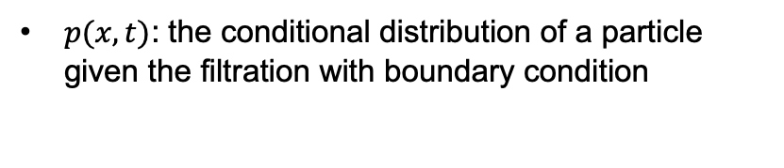
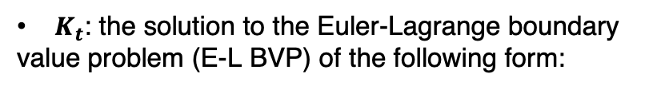
Methods: the benchmarks
Ensemble Kalman-Bucy Filter
(EnKBF):
Continuous version of EnKF
(discretised formula for implementation)
Particle filter:
resampling to avoid degeneracy cases
more particles → particle distribution closer to the true posterior
Feedback Particle Filter:
$K_{t}$: the solution to the Euler-Lagrange boundary
value problem (E-L BVP) of the following form:
$p(x,t)$: the conditional distribution of a particle given the filtration with boundary condition
Figure source:Application of particle filtering for prognostics with measurement uncertainty in nuclear power plants - Scientific Figure on ResearchGate. Available from: https://www.researchgate.net/figure/Procedure-of-particle-filtering_fig3_326833097 [accessed 26 Nov, 2022]

Slide 11
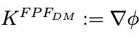
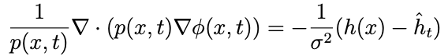
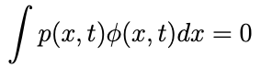
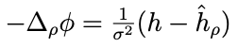
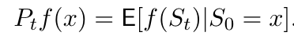
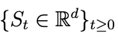
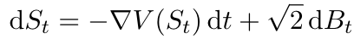
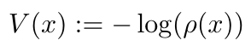
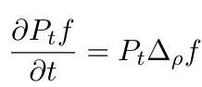
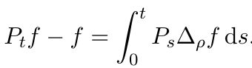
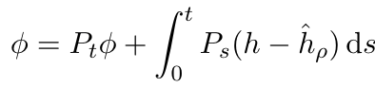
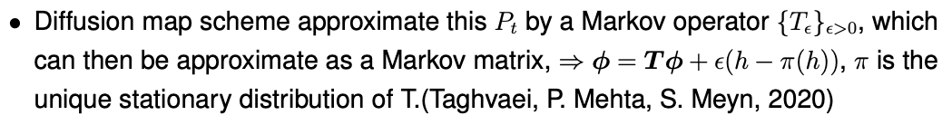
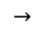
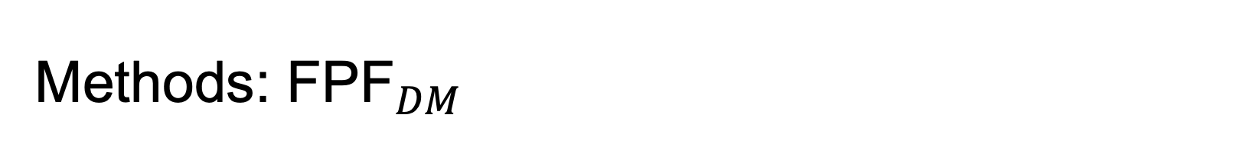
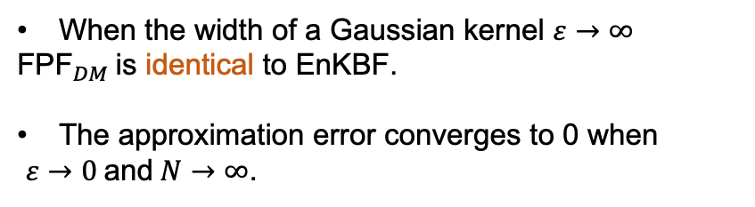
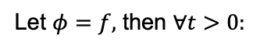
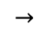
Methods: ${\text{FPF}}_{DM}$
Poisson equation:
with boundary condition
Probability-weighted Laplacian operator $∆_{ρ}$, where $ρ=p(x,t)$.
When the width of a Gaussian kernel $ε→∞$
${\text{FPF}}_{DM}$is identical to EnKBF.
The approximation error converges to 0 when
$ε→0$and$N→∞$.
$$→$$
,
,
$$→$$
Let $φ=f,$ then $∀t>0:$
Taghvaei, A., Mehta, P., Meyn, S. (2020). “Diffusion Map-based Algorithm for Gain Function Approximation in the Feedback Particle Filter”. SIAM/ASA Journal on Uncertainty Quantification 8.3, pp. 1090–1117. doi: 10.1137/19M124513X.
Yang, T., Mehta, P. G., Meyn, S. P. (2013). “Feedback Particle Filter”. IEEE Transactions on Automatic Control 58.10, pp. 2465–2480. doi: 10.1109/TAC.2013.2258825.

Slide 12
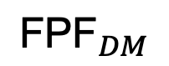
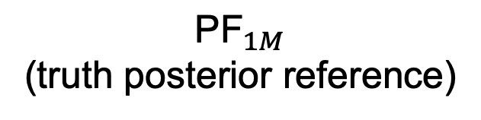
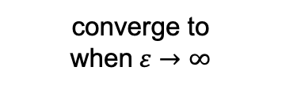
Relations between the methods
converge to when$ε→∞$
$${\text{FPF}}_{DM}$$
EnKBF
Goals:
fewer particles
better estimation
$${\text{PF}}_{1M}$$
(truth posterior reference)
continuous
version
deterministic
version
DEnKF
EnKF

Slide 13
Experiment Results

Slide 14
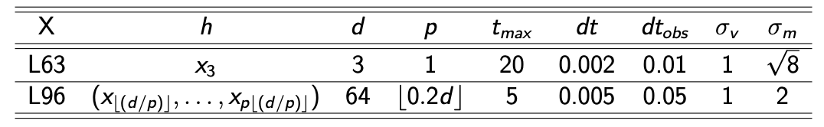
Experiment setting
Table: Settings for Two Cases

Slide 15
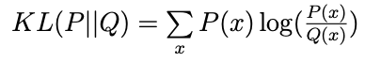
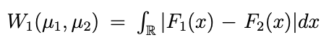
Evaluation Metrics
RMSE: ensemble mean could be not informative for multimodal posteriors.
Kullback-Leibler divergence (KL):
Wasserstein metric (WS):
Evaluation scheme:
Randomly select 10% of the time point.
Calculate the corresponding score between the estimated marginal kernel density and the reference density for each dimension.
Take the overall mean.

Slide 16
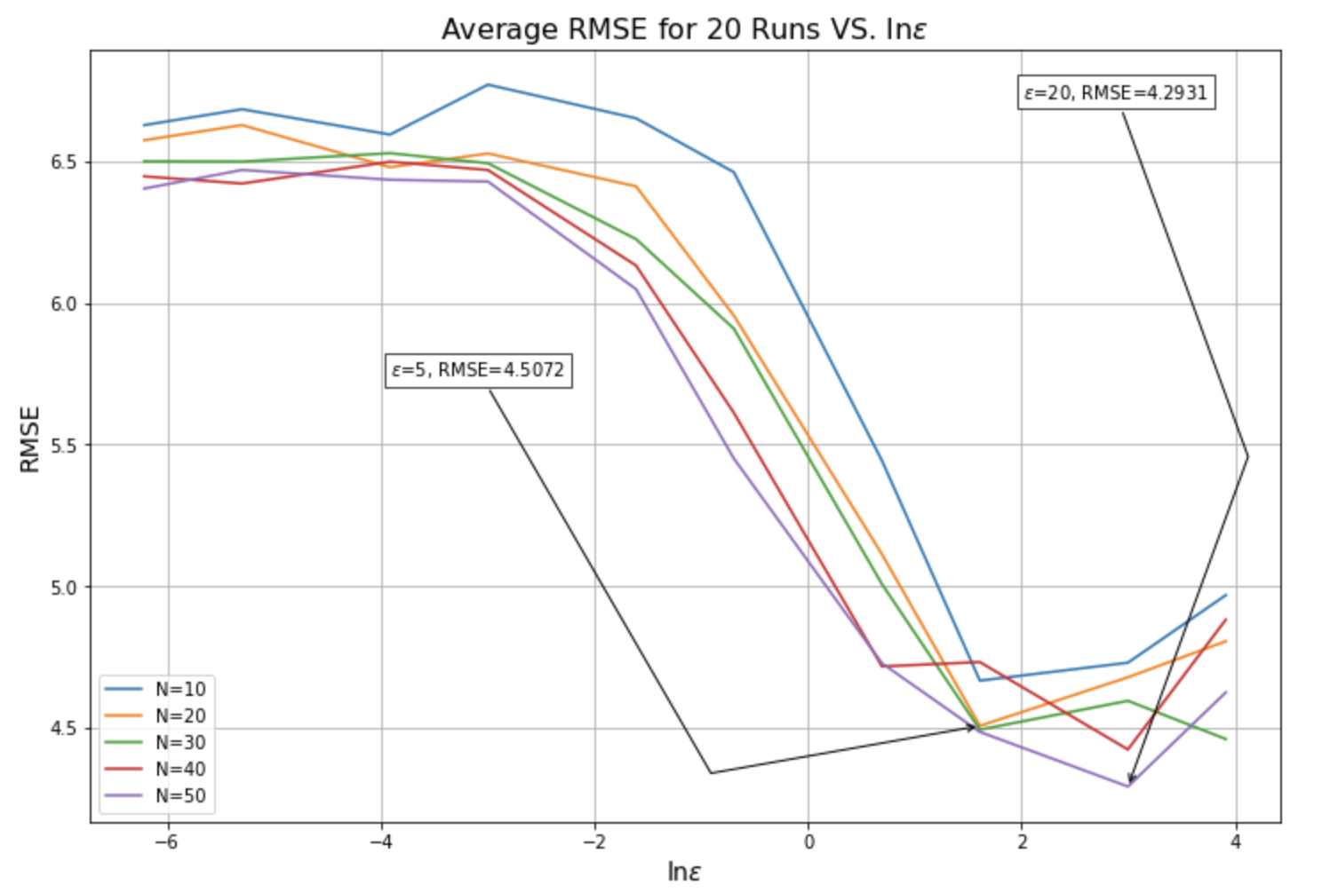
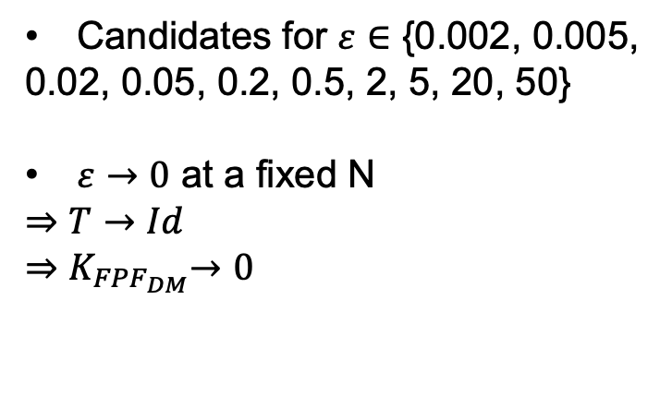
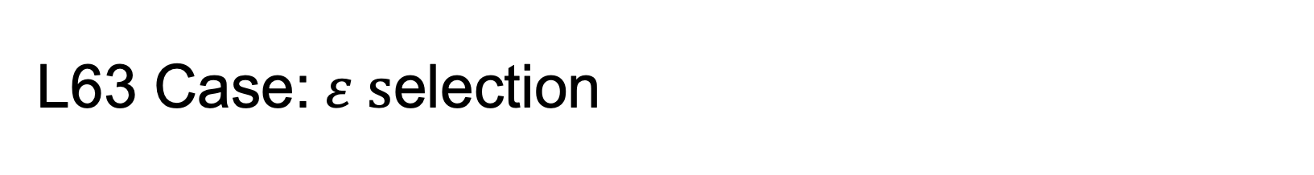
L63 Case:$ε s$election
Candidates for $ε∈$ {0.002, 0.005,
0.02, 0.05, 0.2, 0.5, 2, 5, 20, 50}
$ε→0$ at a fixed N
$⇒$ $T→Id$
$${⇒K}_{{FPF}_{DM}}→0$$

Slide 17

L63 Case: Evaluation Results (N=30)
 | RMSE | KL | WS
DEnKF | 5.5592 | 66.7859 | 0.2221
EnKF | 5.8942 | 70.6285 | 0.2326
EnKBF | 5.4098 | 11.7348 | 0.0857
FPF ($ε=20$) | 5.1431 | 10.7892 | 0.0812
FPF ($ε=5$) | 3.4789 | 10.1378 | 0.0802
Discrete Methods
Continuous Methods

Slide 18

L63 Case: Evaluation Results (N=30)
Observed dimension: $X_{3}$
Figure: Snapshots of the marginal density at three time points.

Slide 19

L96 Case: Evaluation Results (N=30)
 | RMSE | KL | WS
DEnKF | 3.2021 | 24.1275 | 0.1504
EnKF | 3.5614 | 34.4984 | 0.1911
EnKBF | 2.9330 | 1.2681 | 0.0762
FPF ($ε=5$) | 3.1794 | 0.8067 | 0.0754
Discrete Methods
Continuous Methods

Slide 20

L96 Case: Evaluation Results (N=30)
Observed dimension: $X_{9}$
Figure: Snapshots of the marginal density of three randomly chosen dimensions at three time points.

Slide 21

Future works
Search for more high-dimensional “non-Gaussian” behaved simulation cases to test the performance of ${\text{FPF}}_{DM}$method.
Search for appropriate hydrological models to apply the method.

Slide 22
Thank you for listening!

